Slide 1

AGB1211 – DESIGN THINKING
Department of Artificial Intelligence and Data Science
Academic Year: 2024 – 2025 (Odd Semester)
Year :II
Semester :III
Section :A
Date :
PRESENTED BY
1.JANANI V
2.JEEVITHA S
3.JOYNURSINGH J
4.KARKUZHALI S

Slide 2
Title of the Project
HOUSEHOLD WASTE MANAGEMENT
SYSTEM

Slide 3
Problem Identification
The household waste management system faces numerous challenges, including inefficient waste collection, insufficient infrastructure, and a lack of public awareness on proper waste disposal practices. Additionally, inadequate recycling facilities result in valuable materials being sent to landfills, while improper waste disposal poses health and environmental risks. To address these issues, there is a need for efficient waste collection and disposal systems, increased public awareness and education, and the development of adequate recycling facilities to promote sustainable waste management and mitigate associated health and environmental risks.

Slide 4
Objective
The primary objective of this household waste management system project is to design and implement an efficient, sustainable, and community-driven waste management system that minimizes environmental pollution and health risks. The system aims to optimize waste collection, segregation, and disposal processes, while also promoting recycling, reducing waste sent to landfills, and increasing public awareness and participation in proper waste management practices.

Slide 5
BrainStorming
SAMPLE KEYWORDS:
Cleanliness
Waste
Segregation
Composting
Recycling
Disposal
Waste collection
Organic waste
Education & awareness
Vegetable waste
Landfilling & incineration
3 R
Clean society
Pollution control
Household waste
Hazardous waste
management
Segregation
zero waste
Recycling center
public awareness
green waste

Slide 6
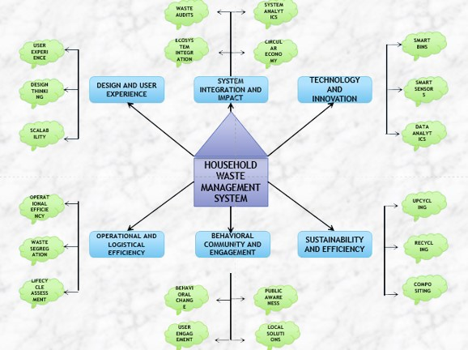
Mind Map

Slide 7
Primary Research
Interviews: Conducting Surveys and Questionnaires, Distributing structured forms to households to gather insights on their waste disposal habits.
one-on-one discussions: With residents, waste workers, or local authorities about waste management challenges.
Observations: Monitoring waste collection processes or household waste segregation practices in real-time.
Focus Groups: Bringing together a group of participants to discuss waste management issues and share experiences.
Case Studies: Examining specific neighborhoods or communities to explore their waste management systems in detail.

Slide 8
Secondary Research
Government Reports: Data on municipal waste management practices and policies.
Academic Research: Studies and articles on waste management systems and their challenges.
Industry Publications: Reports from waste management companies or environmental organizations.
Online Databases: Statistics and trends related to waste generation and disposal.
Media Articles: News articles or features discussing waste management issues in various regions.

Slide 9
Proposed Work
A household waste management system begins with the Waste Generation and Segregation Module, where waste is sorted at the source into categories like organic, recyclable, hazardous, and general. Color-coded bins and awareness campaigns ensure proper segregation. The Collection and Transportation Module uses scheduled pickups and GPS-enabled vehicles to streamline waste movement while maintaining segregation. In the Waste Processing and Treatment Module, organic waste is composted or used for biogas production, and non-organic waste is sorted for further processing. The Resource Recovery and Recycling Module focuses on extracting reusable materials and recycling them into new products. Finally, the Disposal and Feedback Module ensures safe disposal of residual waste in landfills while providing feedback to improve the system’s efficiency.

Slide 10
List of Modules
WASTE GENERATION AND SEGREGATION MODULE
COLLECTION AND TRANSPORTATION MODULE
WASTE PROCESSING AND TREATMENT MODULE
RESOURCE RECOVERY AND RECYCLING MODULE
DISPOSAL AND FEEDBACK MODULE

Slide 11
Module 1 Description
WASTE GENERATION AND SEGREGATION MODULE:
This module focuses on waste generation at the household level and encourages proper segregation of waste into categories such as biodegradable, recyclable, and hazardous materials. It may include the use of separate bins and awareness programs to guide households in segregating their waste correctly. dule one slide

Slide 12
Module 2 Description
COLLECTION AND TRANSPORTATION MODULE :
The collection module ensures that segregated waste is gathered from households regularly. Waste is then transported efficiently to processing or recycling centers. This module includes scheduling, routing, and waste handling mechanisms to ensure timely and clean collection and transportation.

Slide 13
Module 3 Description
WASTE PROCESSING AND TREATMENT MODULE :
This module handles the processing of waste at central facilities. It includes composting for biodegradable waste, recycling of recyclable materials, and safe disposal or treatment of hazardous waste. Advanced technologies like biogas plants or waste-to-energy systems may be part of this module.

Slide 14


Module 4 Description
RESOURCE RECOVERY AND RECYCLING MODULE:
Focused on the recovery of valuable resources from waste, this module deals with sorting, cleaning, and processing recyclable materials. It aims to reduce the amount of waste sent to landfills and recover materials like metals, plastics, and paper to be reused in manufacturing or for energy production.

Slide 15


Module 5 Description
DISPOSAL AND FEEDBACK MODULE:
The disposal module manages the final step where non-recyclable and processed waste is either sent to landfills or incinerated. The feedback system monitors the effectiveness of the entire waste management process, collecting data to improve operations, identify trends, and encourage better waste practices through community engagement and technology.

Slide 16
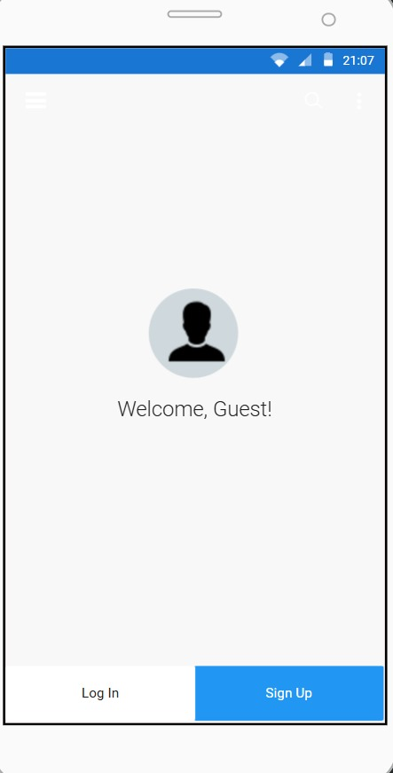
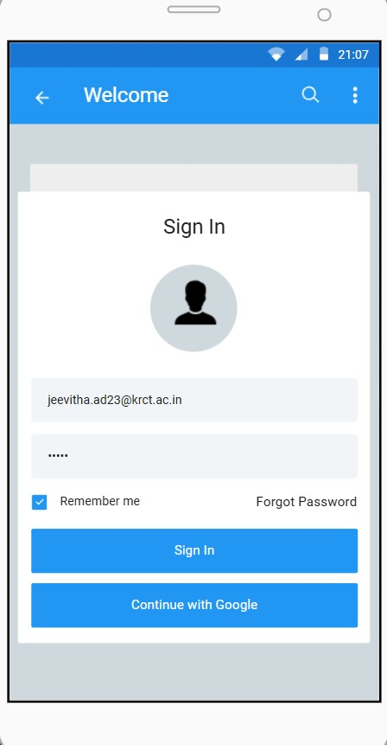
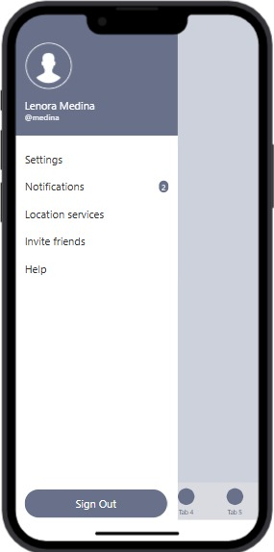
Results

Slide 17
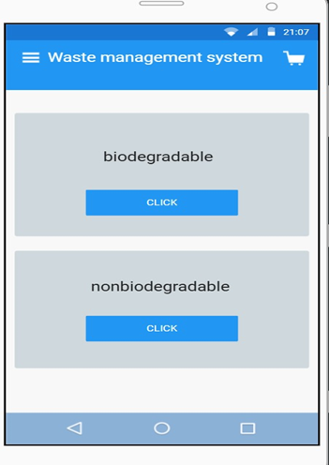
Results

Slide 18
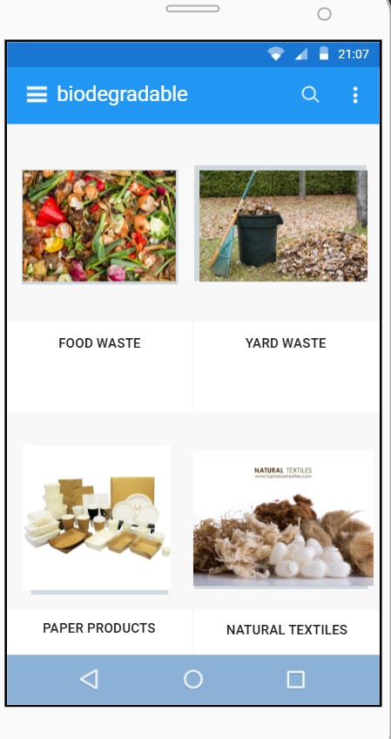
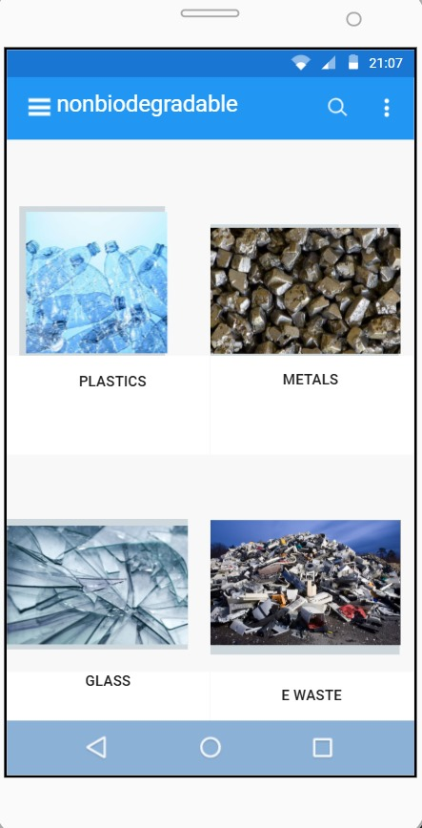
Results

Slide 19
Conclusion
An effective household waste management system is crucial for promoting environmental sustainability, public health, and efficient resource utilization. By focusing on waste generation, segregation, collection, processing, and disposal, such systems help minimize environmental impact, reduce landfill usage, and encourage recycling and resource recovery. Integrating modern technologies and fostering community awareness can significantly enhance the system's efficiency and effectiveness.well-designed waste management system not only addresses immediate waste disposal challenges but also supports long-term sustainability goal by conserving resources, reducing pollution, and promoting responsible consumption and waste practices.

Slide 20
Thank You
Any queries???

